Slide 1

NYC Taxi Data Analysis - Data Flow, Execution, and Results “Exploring the Medallion Architecture and Advanced Insights”
Tushar Chotlani, Pratik Jaiswal and Arpan Jaiswal

Slide 2
Project Project Overview
Objective:
To build a robust data Pipeline to ingest, transform, analyze and create a model on NYC taxi data.
Key Features
Dynamic data ingestion using APIs
Data transformation and cleaning with PySpark
Data storage and versioning with Delta Lake
Medallion architecture implementation
Tools and Technologies
Azure Data Factory
Azure Databricks
Delta Lake
Python
SQL

Slide 3
NYC Dataset
Source
NYC Taxi Trip data
Source Webpage:
https://www.nyc.gov/site/tlc/about/tlc-trip-record-data.page
Data Source:
https://d37ci6vzurychx.cloudfront.net/trip-data/green_tripdata_2024-01.parquet
Format
parquet

Slide 4
Compact Summary: Green LPEP Trip Records
Category | Field | Description
Trip Details | VendorID | Provider (1 = Creative Mobile, 2 = VeriFone)
 | Pickup & Dropoff Times | Start (pickup_datetime) and end (dropoff_datetime) of the trip
 | Passenger_count | Number of passengers (driver-entered)
 | Trip_distance | Distance in miles (from taximeter)
 | Location IDs | Pickup (PULocationID) & Dropoff (DOLocationID) TLC Zones
Rate Info | RateCodeID | Fare type (1 = Standard, 2 = JFK, etc.)
Payment Details | Payment_type | Payment method (1 = Credit card, 2 = Cash, etc.)
 | Fare Components | Fare, Extras (rush hour/overnight fees), MTA tax ($0.50), Improvement surcharge ($0.30), Tolls
 | Total_amount | Total (excluding cash tips); Tips auto-added for card payments
Metadata | Store_and_fwd_flag | Trip stored onboard? (Y = Yes, N = No)
 | Trip_type | 1 = Street-hail, 2 = Dispatch

Slide 5
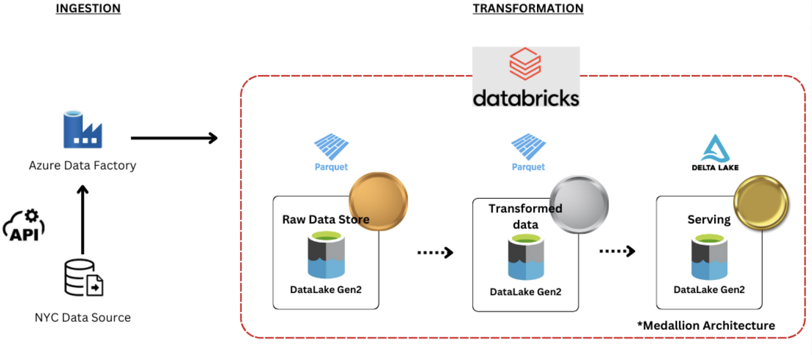
Data Flow
• Bronze Layer: Raw data ingestion from NYC Taxi dataset.
• Silver Layer: Data cleaning, transformation, and intermediate storage.
• Gold Layer: Analytics-ready datasets and Delta Tables.

Slide 6
Components Used
Azure Databricks: Platform for data processing.
Azure Data Lake Storage (ADLS): For storing Bronze, Silver, and Gold layers.
Spark SQL: For data queries and transformations.
Machine Learning Models: Linear Regression, Decision Trees, Random Forest.

Slide 7
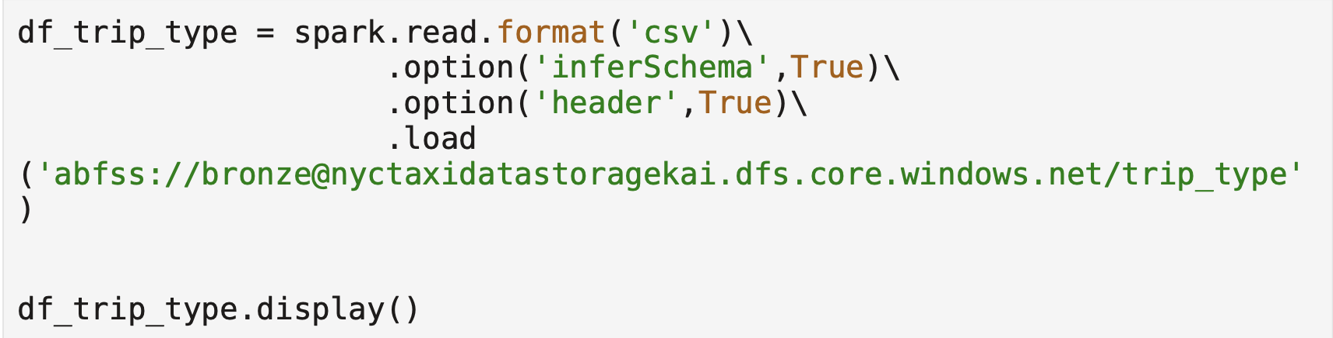
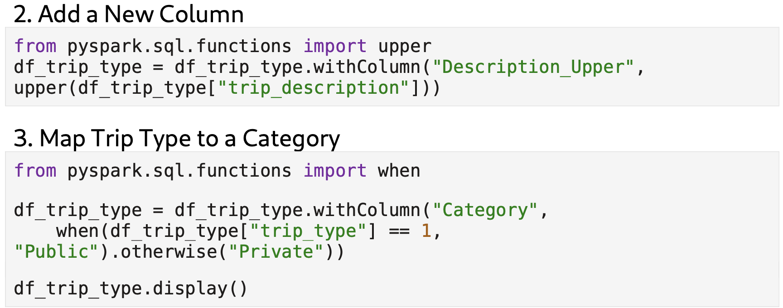
High-Level Source Code Overview (Bronze to Silver)
Objective
Ingest raw data and clean it for intermediate processing.
Data Loading
Loads raw trip data from the Bronze Layer stored in Azure Data Lake.
Uses inferSchema to automatically detect column types.
Data Cleaning:
Normalizes column names and creates a new column (Category) to categorize trip types (e.g., Public vs. Private).

Slide 8
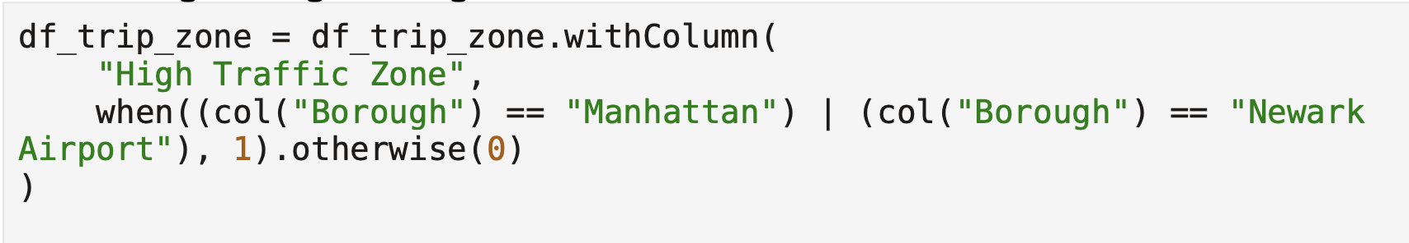
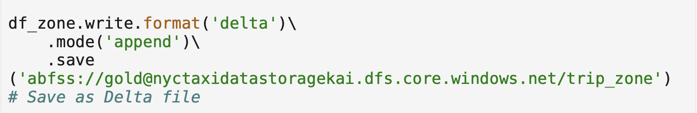
High-Level Source Code Overview (Silver to Gold)
Objective
Refine data for analytics and store it in Delta format.
Data Transformation
Adds a new column High Traffic Zone to flag high-demand areas.
Writing Delta Table
Saves the refined data into the Gold Layer using Delta Lake for optimized storage and versioning.

Slide 9

High-Level Source Code Overview (Machine Learning Results - Summary)
1. Overview of Models Used:
Three machine learning models were trained and evaluated for predicting total trip fares:
Linear Regression
Decision Tree Regressor
Random Forest Regressor
2. Performance Metrics:
Linear Regression outperformed the other models with:
Lowest RMSE: 4.31
Highest R²: 0.96 (indicating excellent predictive power)
Decision Tree and Random Forest performed less accurately, with higher RMSE and lower R² values.

Slide 10
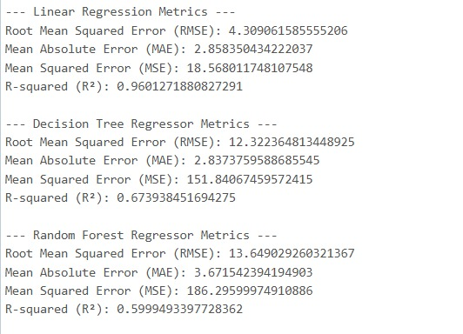
High-Level Source Code Overview (Machine Learning Results - Summary)
Metric | Linear Regression | Decision Tree | Random Forest
Root Mean Squared Error (RMSE) | 4.31 | 12.32 | 13.65
Mean Absolute Error (MAE) | 2.86 | 2.83 | 3.67
Mean Squared Error (MSE) | 18.57 | 151.84 | 186.30
R² (Coefficient of Determination) | 0.96 | 0.67 | 0.60

Slide 11

Challenges Faced and Solutions
Challenges:
Handling missing values in raw data.
Balancing model complexity vs. accuracy.
Managing large-scale data with efficiency.
• Solutions:
Used Delta Lake for efficient storage and versioning.
Applied transformations to clean and enrich data.
Used Spark MLlib for scalable machine learning.

Slide 12
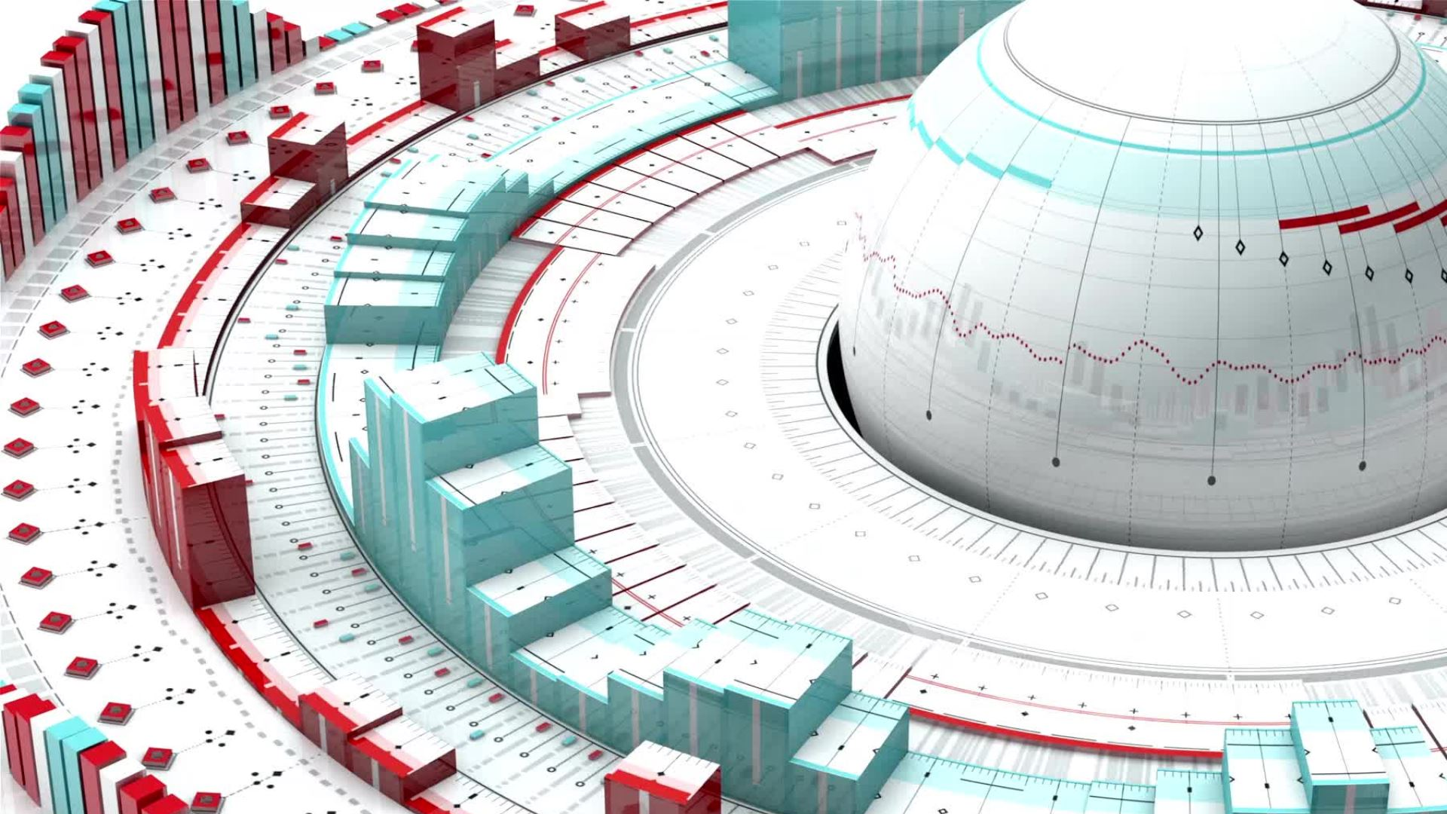
Summary and Business Impact
Summary:
Medallion architecture ensures data traceability and quality.
Insights like high-demand zones and seasonal trends improve planning.
Machine learning models provide accurate fare predictions.
• Business Impact:
Resource optimization based on high-traffic zones.
Improved revenue forecasting with seasonal trends.

Slide 13

Thank you

